Slide 1


Generalized Psychophysiological Interactions: Theory and Applications (gPPI)
Donald G. McLaren, PhD
GRECC, ENRM Veteran’s Hospital
Department of Neurology, MGH/HMS
4/13/2013

Slide 2
Financial Disclosures
None related to this talk.

Slide 3
Resting State Connectivity

Slide 4
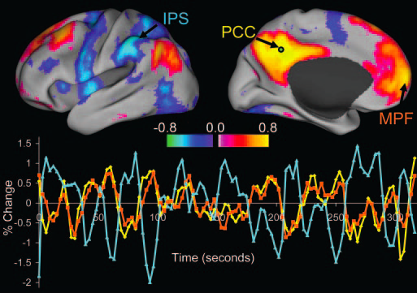
Notes:
Resting state shows where time courses are correlated.

Slide 5
With This Method (and ICA)…
I will show that 1 person scanned today and another person scanned next week doing a simple block design visual task have functional connected brains.

Slide 6
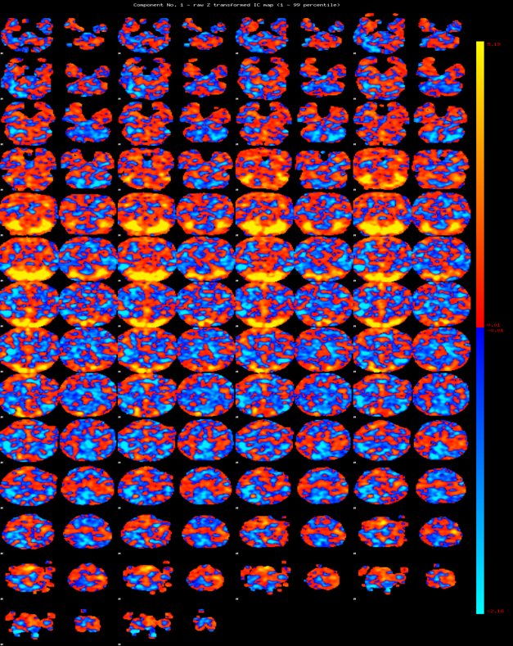
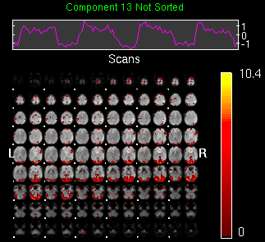
Melodic ICA
GIFT ICA
Notes:
Alternating slices represent different individuals. As you can see, there is a shared component between the brains.

Slide 7
Resting Methods in Task Data: Pure Resting Data
ICA or Seed-Based (e.g. degree connectivity)
 | voxel 2 | voxel3
voxel1 | 0.067154913 | 0.456587852
voxel2 |  | 0.918332054
voxel3
Notes:
2 correlated voxels (series 2 and series 3) and 1 uncorrelated voxel.

Slide 8
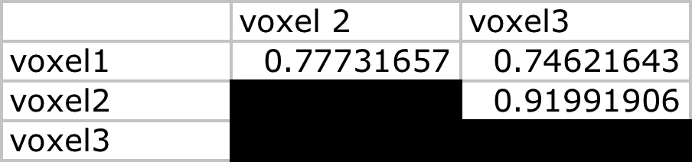
Resting Methods in Task Data: Task Added to All 3 Voxels
ICA or Seed-Based (e.g. degree connectivity)
Notes:
2 correlated voxels (series 2 and series 3) and 1 uncorrelated voxel with task evoked activity in all 3 voxels. Notice how all voxels are now strongly correlated.

Slide 9

Resting Methods in Task Data: Task Added to 2 Least Correlated Voxels
ICA or Seed-Based (e.g. degree connectivity)
Notes:
2 correlated voxels (series 2 and series 3) and 1 uncorrelated voxel with task added to series 1 and series 2. The correlation increases between these 2 voxels and decreases between series 2 and 3. So, task has an unpredictable effect on connectivity depending on whether a voxel is active or not.

Slide 10
Applying Resting Methods To Task Data
While it can be done, the interpretation changes dramatically.
We are interested in the connectivity during the task, which isn’t being provided in most task designs – unless you have a 2-3+ minute block.
Thus, we need another method.

Slide 11
How Can We Identify Connectivity Differences (and Similarities)

Slide 12
Psychophysiological Interactions Context-Dependent Connectivity

Slide 13
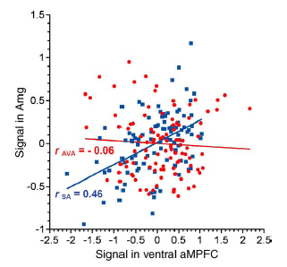
Context-Dependent Connectivity
Time
(Schmitz and Johnson 2006)

Slide 14
Context-Dependent Connectivity
Time

Slide 15
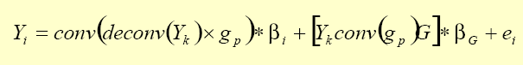
Context-Dependent Connectivity
Coincident (or nearly coincident) neural events (not BOLD) in different brain regions produce similar BOLD response profile shapes
X amount of neural stimulation will always lead to X BOLD response profile shape
We assume in any fMRI analysis that the neural response (not BOLD) do not overlap.
Time
(Gitelman et al. 2003)

Slide 16
A Statistical Thought To Consider…

Slide 17
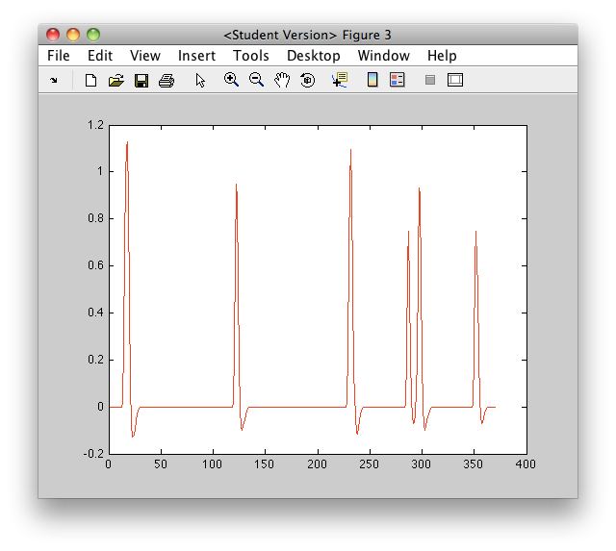
A Statistical Thought To Consider…
Notes:
Task A activation HRF regressor.

Slide 18
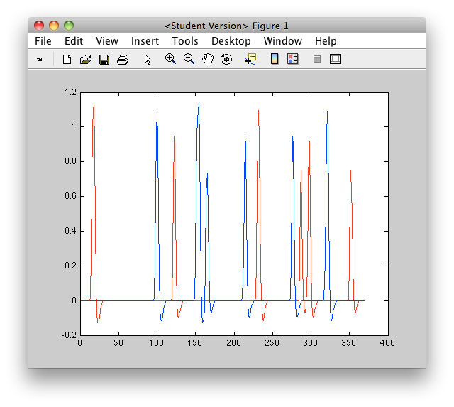
A Statistical Thought To Consider…
Notes:
Task A and Task B activation HRF regressors.

Slide 19
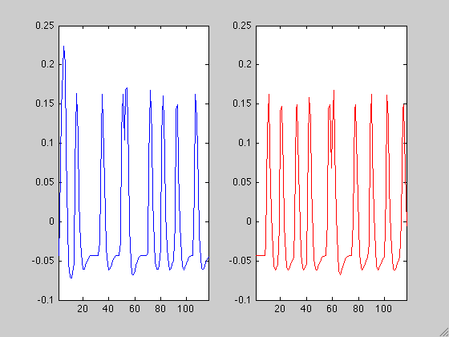
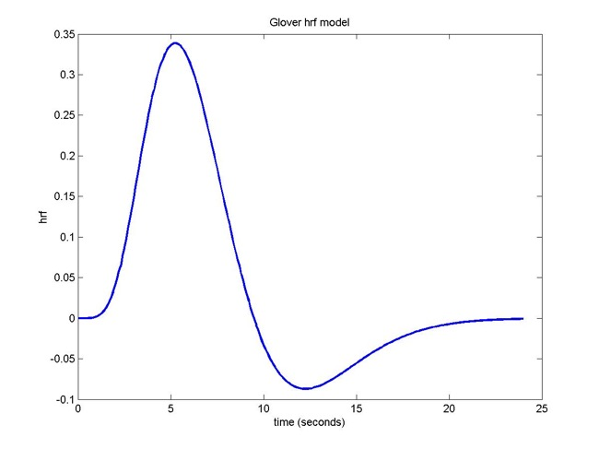
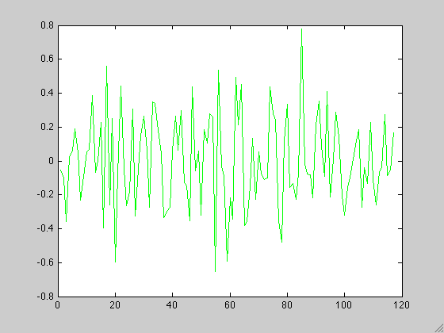
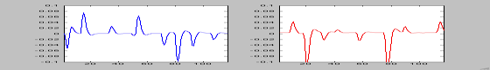
Context-Dependent Connectivity
Time

Slide 20
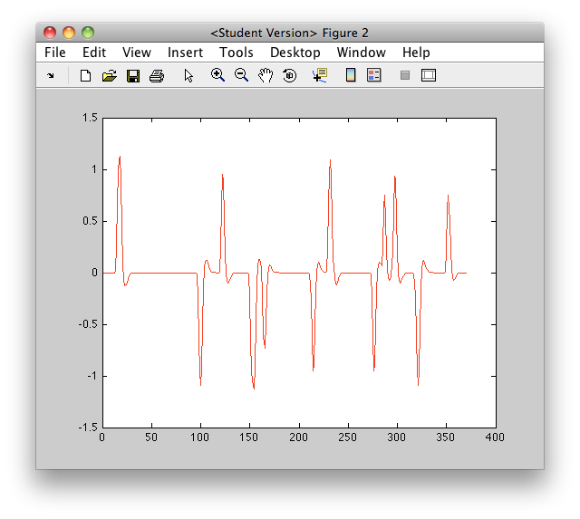
A Statistical Thought To Consider…
Notes:
Task A – Task B activation HRF regressor, but we’d never do this…. Why would we do it in PPI? We shouldn’t but this has been the approach adopted by SPM. gPPI will shift the approach to separate regressors for each task.

Slide 21
A Statistical Thought To Consider…
Notes:
Task A and Task activation HRF regressors. We will use the approach of separate regressors in SPM.

Slide 22
sPPI vs gPPI
(McLaren et al. 2012)
Notes:
gPPI is the right graphs (and E). D is task regressors. G is PPI regressors.
sPPI is the left graphs (and E). C is the task regressor. F is the PPI regressor.

Slide 23
Simulations
Using the gPPI framework, we simulated different interaction models.
PPI Term
Psychological/Task Term
Seed Term
Constant
[0.5 -0.5 0.5 -0.5 .25 100]
[a a-1 0.5 -0.5 .25 100]

Slide 24
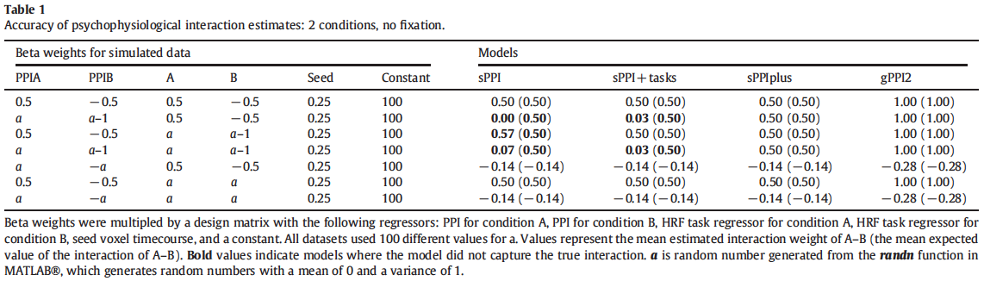
Simulations=Accuracy
(McLaren et al. 2012)

Slide 25
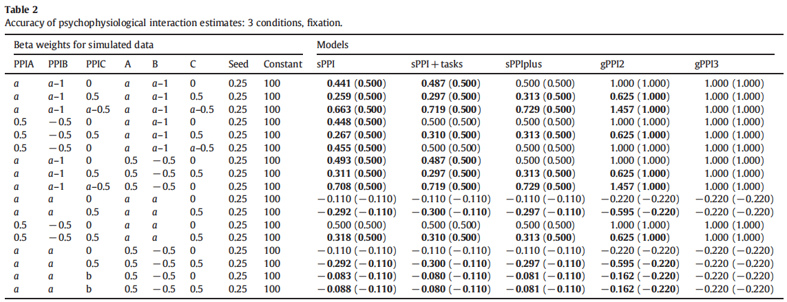
Simulations=Accuracy
(McLaren et al. 2012)

Slide 26
Simulations=Significance
Table 3. Robustness of PPI Estimates and Significance=2 Conditions
 | Models
Model Parameters | sPPI | sPPI+tasks | sPPIplus | gPPI2 | Single Condition
PPI Effect
1 Condition plus fixation | 0.99 (0.01) | 0.99 (0.01) | 0.99 (0.01) | 0.99 (0.01) | 0.99 (0.01)
2 Conditions (A-B) | 0.49 (0.01) | 0.49 (0.01) | 0.49 (0.01) | 0.98 (0.02) | 0.40 (0.01)
2 Conditions (same data as 1 Condition model) | 0.88 (0.02) | 0.88 (0.02) | 0.49 (0.01) | 0.98 (0.02) | 0.99 (0.01)
2 Conditions (effectively the same as 2 Conditions (A-B)) | 0.49 (0.01) | 0.49 (0.01) | 0.49 (0.01) | 0.98 (0.02) | 0.40 (0.01)
2 Conditions | 0.88 (0.02) | 0.88 (0.02) | 0.49 (0.01) | 0.98 (0.02) | 1.00 (0.01)
2 Conditions plus fixation | 0.71 (0.03) | 0.58 (0.03) | 0.51 (0.01) | 1.02 (0.01) | 1.91 (0.01)
No PPI Effect
2 Conditions plus fixation | 0.15 (0.01) | 0.01 (0.01) | 0.01 (0.01) | 0.02 (0.1) | 0.06 (0.01)
(McLaren et al. 2012)

Slide 27
Akaike Information Criterion

Slide 28
Simulations=Model Fit
Table S1. Simulation Model Fits=2 Conditions
 | Model
Simulated Data | sPPI+tasks | sPPIplus | gPPI2 | Single Condition
PPI Effects
1 Condition plus fixation | 0.00 | 0.00 | 0.00 | 0.00
2 Conditions (A-B) | -10.17 | -9.19 | -9.19 | 18.63
2 Conditions (same data as 1 Condition model) | -1.77 | -72.13 | -72.13 | -72.37
2 Conditions (effectively the same as 2 Conditions (A-B)) | -10.17 | -9.19 | -9.19 | 18.63
2 Conditions | -7.28 | -77.64 | -77.64 | -63.36
2 Conditions plus fixation | -19.30 | -264.42 | -264.42 | -112.01
No PPI Effects
2 Conditions plus fixation | -136.92 | -137.57 | -137.57 | -29.95
(McLaren et al. 2012)
Notes:
gPPI is clearly the better model from the model fitting perspective. Anything below -7 means you should really use the model with more regressors.

Slide 29
Simulations=Significance
Table 4. Robustness of PPI Estimates and Significance=3 Conditions, Fixation
 | Models
Model Parameters | sPPI | sPPI+tasks | sPPIplus | gPPI2 | gPPI3
PPI Effect
PPIA=1;PPIB=0.75; PPIC=0 | 0.15 (0.02) | 0.12 (0.02) | 0.12 (0.01) | 0.24 (0.01) | 0.25 (0.01)
PPIA=1;PPIB=0.75; PPIC=0.5 | -0.02 (0.02) | -0.06 (0.02) | -0.06 (0.01) | -0.12 (0.02) | 0.25 (0.01)
PPIA=0.125; PPIB=-0.125;PPIC=0 | 0.15 (0.01) | 0.12 (0.01) | 0.12 (0.01) | 0.24 (0.01) | 0.25 (0.01)
PPIA=0.125; PPIB=-0.125;PPIC=0.5 | -0.03 (0.01) | -0.06 (0.01) | -0.06 (0.01) | -0.13 (0.02) | 0.25 (0.01)
No PPI Effect
PPIA=0;PPIB=0; PPIC=0 | 0.02 (0.01) | -0.01 (0.01) | -0.01 (0.01) | -0.01 (0.01) | 0.00 (0.01)
PPIA=0;PPIB=0; PPIC=0.5 | -0.16 (0.01) | -0.19 (0.01) | -0.19 (0.01) | -0.38 (0.02) | 0.00 (0.01)
PPIA=0;PPIB=0; PPIC=-0.5 | 0.20 (0.01) | 0.18 (0.01) | 0.18 (0.01) | 0.35 (0.01) | 0.00 (0.01)
Notes:
sPPI leads to false positives or false negatives.

Slide 31
sPPI vs. gPPI=Contrasts
(McLaren et al. 2012)
Notes:
Some regions are found only in sPPI, while some are found in all three methods, and some are only found in gPPI methods.

Slide 32
sPPI vs gPPI=Model Fit
(McLaren et al. 2012)
Notes:
Regions in sPPI that disappear have poor model fit. Regions that appear or stay in with gPPI have better similar model fits.

Slide 33
Flexibility of gPPI
(McLaren et al. 2012)

Slide 34
Conjunctions – Where Are Tasks Similar
(McLaren et al. 2012)

Slide 35
Conclusions
Increased accuracy of the connectivity model
Increased sensitivity and specificity
Get the connectivity for each task
Only requires a single model
Fully Automated

Slide 37
Practical

Slide 38
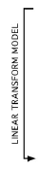
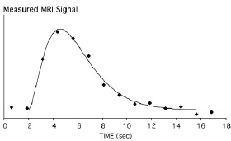
Caveat 1: The Inverse Problem
Hemodynamic Inverse Problem
Stimulus
(Adapted from Bucker 2003)

Slide 39
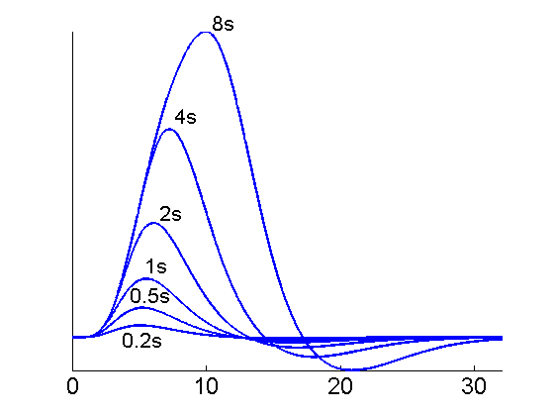
The Inverse Problem: Task Duration

Slide 40
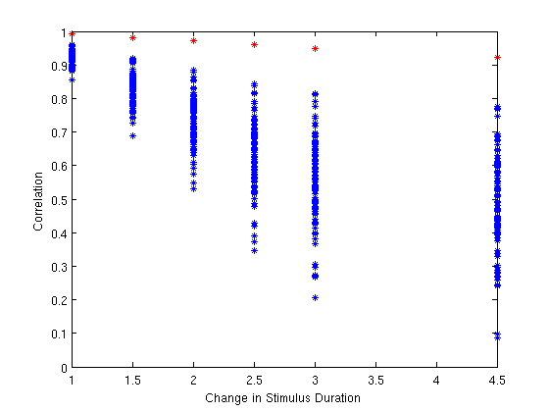
The Inverse Problem: Neuronal Activity and PPI

Slide 41
Caveat 1=Neuronal Activity

Slide 42
Estimated Neural Activity
BOLD Signal (a.u.)
Seconds

Slide 43
Estimated Neural Activity
Correlation Coefficient
Notes:
Correlation between convolved neural activity and the BOLD signal. Generally, all your subjects should be above 0.7.

Slide 44
Analysis in progress
QC of deconvolution and trial duration

Slide 45
Caveat 2
PPI is only as good as your model

Slide 46
Caveat 3: Collinearity due to few trials
Analysis in progress to show these effects and concatenation as a solution

Slide 48
Applications
Snake Phobia
Swallowing
Brain-Behavior Correlations
Pharmacology

Slide 49
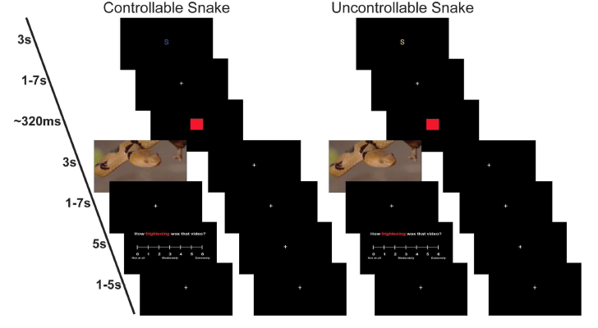
Controllability in Snake Phobics
(Kerr et al. 2012/3)

Slide 50
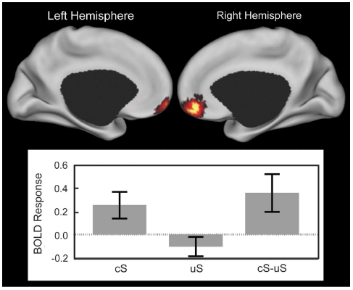
Controllability in Snake Phobics
(Kerr et al. 2012/3)

Slide 51
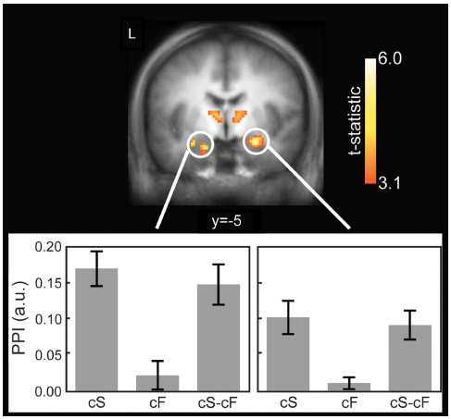
Controllability in Snake Phobics
(Kerr et al. 2012/3)

Slide 53
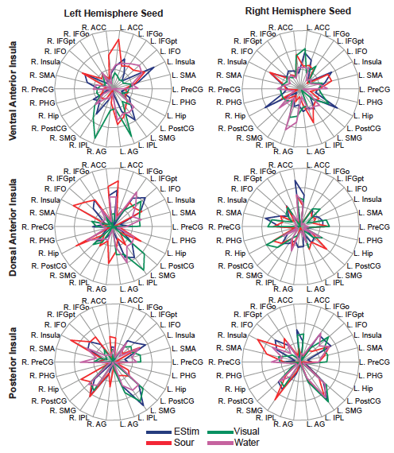
Swallowing
(Humbert and McLaren, in prep)

Slide 55
Correlations with Cognition in AD
(McLaren et al., in prep)

Slide 56
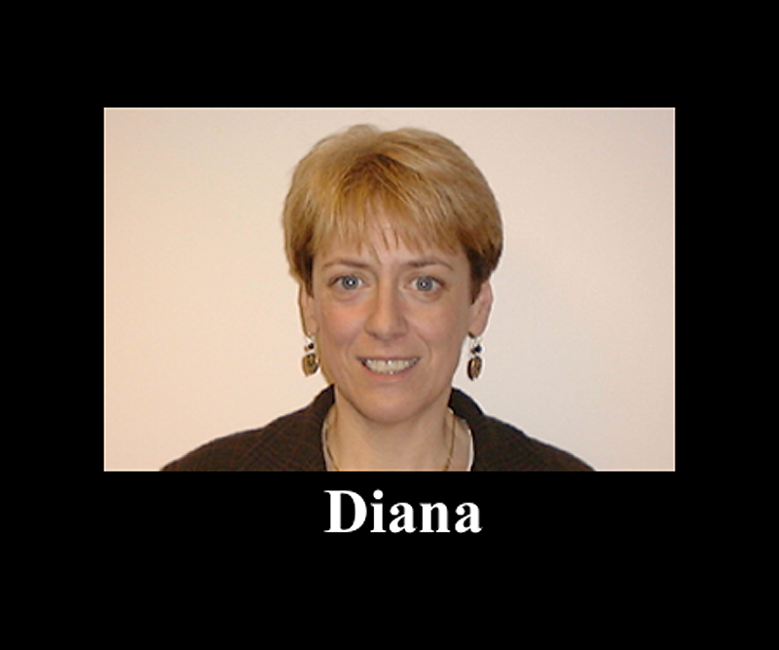
Task Stimuli

Slide 57
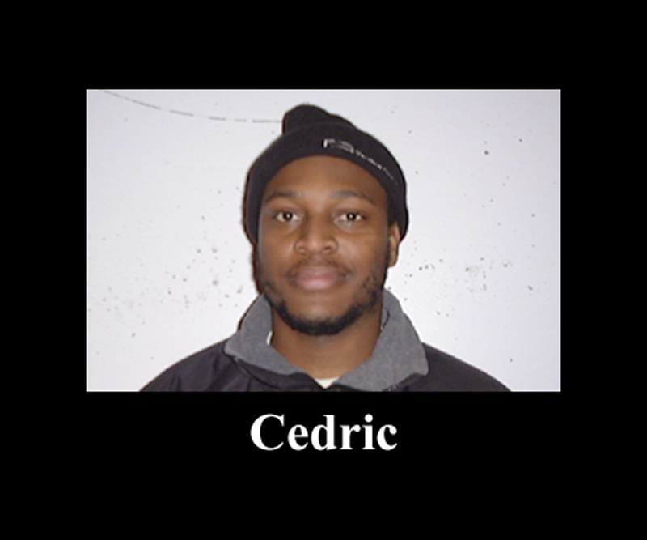
Task Stimuli

Slide 59
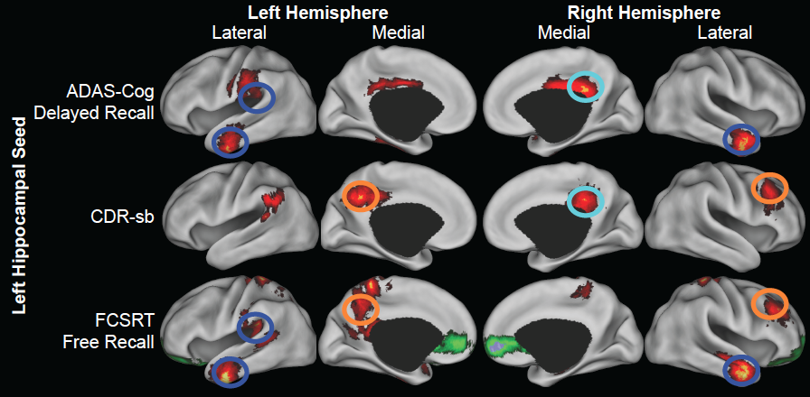
Correlations

Slide 60
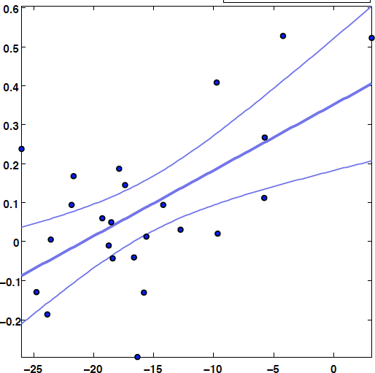
Correlations

Slide 61
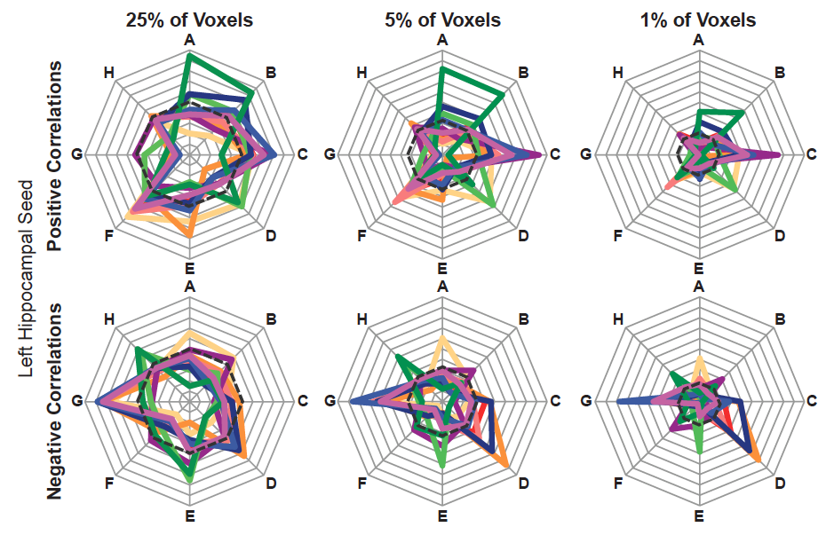
Correlations

Slide 62
Future Directions
Integrate fMRI task, gPPI, and CBF into our understanding of the brain
Develop graph theory for gPPI
Develop gPPI for the resting state
Develop gPPI as a biomarker of cognitive function in preclinical AD

Slide 63
Acknowledgements
Harvard Aging Brain Project
Dr. Reisa Sperling
Dr. Alireza Atri
Dr. Aaron Schultz
Aishwarya Sreenivasan
Andrew Ward
Dr. Koene Van Dijk
Dr. Willem Huijbers
Dr. Dorene Rentz
Dr. Trey Hedden
Dr. Bob Spunt
Dr. Darren Gitelman
Justin Vincent
Wisconsin Alzheimer’s Disease Research Center
Imaging Core (Dr. Sterling Johnson, Dr. Michele Ries, Dr. Guofan Xu, Elisa Canu, Erik Kastman)
Dr. Mark Sager
Dr. Sanjay Asthana
Washington University
Dr. Harold Burton
Dr. Josh Shimony
Dr. David Van Essen
Dr. Avi Snyder
Dr. Mark McAvoy
Adrian Epstein
Dr. Ianessa Humbert
Deborah Kerr

